Slide 1
RDBMS – Day 3
ER/CORP/CRS/DB07/003
Ver. No.: 3.0

Slide 2
Recap
Logical Database Design
Converting ER Diagrams to relational schema
Normalization 1NF, 2NF, 3NF, BCNF
De-normalization
Merits and Demerits of Normalization

Slide 3
Session Plan
Introduction to SQL
DDL Statements
  Create Table
  Alter Table
  Drop Table
  Truncate Table
Create Index
Merits & Demerits of Index
Relational Operators
DML Statements
  Insert into
  Delete from
  Select …
  Update …

Slide 4
SQL
SQL is used to make a request to retrieve data from a Database.
The DBMS processes the SQL request, retrieves the requested data from the Database, and returns it.
This process of requesting data from a Database and receiving back the results is called a Database Query and hence the name Structured Query Language.

Slide 5
SQL
SQL is a language that all commercial RDBMS implementations understand.
SQL is a non-procedural language
We would be discussing SQL with respect to oracle syntax
Notes:
You can’t write programs like the ones you would have done using C language
You can only write questions in English like language called queries which will fetch some data rows from the database.

Slide 6
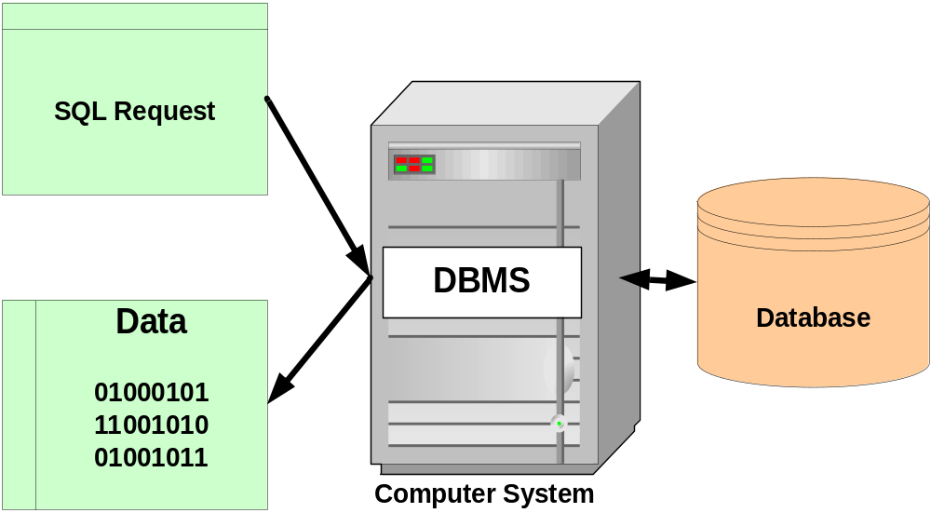
Structured Query Language (SQL)

Slide 7
Structured Query Language (SQL)
1979 Oracle Corporation introduces the first commercial RDBMS
1982 ANSI (American National Standards Institute) forms SQL Standards Committee
1983 IBM (International Business Machine) announces DB2 (a Database)
1986 ANSI (American National Standards Institute) SQL1 standard is approved
1987 ISO (International Organization for Standardization) SQL1 standard is approved
1992 ANSI (American National Standards Institute) SQL2 standard is approved
2000 Microsoft Corporation introduces SQL Server 2000, aimed at enterprise applications
2004 SQL: 2003 standard is published

Slide 8
Statements
DDL (Data Definition Language)
  Create
  Alter
  Drop
  Truncate
DML (Data Manipulation Language)
  Insert
  Update
  Delete
  Select
DCL (Data Control Language)
  Grant
  Revoke
  Commit
  Rollback
Notes:
SQL has three flavours of statements. The DDL, DML and DCL.
DDL is Data Definition Language statements. Some examples:
CREATE – to create objects in the database
ALTER – to alter the structure of the database
DROP – to delete objects from the database
TRUNCATE – to remove all records from a table. The space allocated for the records is also removed
COMMENT – to add comments to the data dictionary
GRANT – to give user access privileges to database objects
REVOKE – to withdraw access privileges given with the GRANT command
DML is Data Manipulation Language statements. Some examples:
SELECT – to retrieve data from the database
INSERT – to insert data into a table
UPDATE – to update existing data within a table
DELETE – to delete all records from a table. The space allocated for the records remains intact
CALL – to call a PL/SQL or Java subprogram
EXPLAIN PLAN - explain access path to data
LOCK TABLE – to control concurrency
DCL is Data Control Language statements. Some examples:
COMMIT – to save the work done
SAVEPOINT – to identify a point in a transaction to which you can later roll back
ROLLBACK – to restore database to original since the last COMMIT
SET TRANSACTION - Change transaction options like what rollback segment to use

Slide 9
Data types
Number
Char
Varchar2
Long
date
Notes:
SQL supports various data types
Integers
Decimal numbers--- NUMBER, INTEGER .
Number is an oracle data type. Integer is an ANSI data type. Integer is equivalent of NUMBER(38)
The syntax for NUMBER is NUMBER(P,S) p is the precision and s is the scale. P can range from 1 to 38 and s from -84 to 127
Floating point numbers---- FLOAT
Fixed length character strings---- CHAR [<size>]
The CHAR data type is fixed length, with the maximum size of the column specified in parentheses. Specifying the size is optional, and the default size is 1 byte.
The maximum allowed size in a CHAR data type column is 2000 bytes.
Variable length character strings --- VARCHAR2(<size>)
A maximum size for the column should be defined. Unlike CHAR columns, VARCHAR2 columns are not blank-padded with trailing spaces if the column value is shorter than its maximum specified length. The range is values allowed for size is from 1 to 4000 bytes.
Dates-----DATE
The DATE data type stores date and time information. You can store the dates from January 1, 4712 BC to December 31, 9999 AD.
LONG
LONG columns can store up to 2GB of data. There can be only one LONG column in the table definition.

Slide 10
NULL
Missing/unknown/inapplicable data represented as a NULL value
NULL is not a data value. It is just an indicator that the value is unknown

Slide 11
Operators
Arithmetic operators: +, -, *, /
Logical operators: AND, OR, NOT
Relational operators: =, <=, >=, < >, < , >
Notes:
The Arithmetic operators are used to calculate something like given in the example below:
Select * from employee where sal * 1.1 > 1000 ;
The logical operators are used to combine conditions like:
Select * from employee where (sal > 1000 AND age > 25);
The above two examples also illustrate the use of relational operators.

Slide 12

SQL-Data Definition Language

Slide 13
Types Of Constraints
Column Level
Table level

Slide 14
Types Of Constraints
Primary Key Constraint
Foreign Key Constraint
Unique Constraint
Check Constraint
Not Null Constraint

Slide 15
SQL - CREATE TABLE
Syntax:
CREATE TABLE tablename
(
column_name data_ type constraints, …
);
Notes:
Used to create a table by defining its structure, the data type and name of the various columns, the relationships with columns of other tables etc.
Table names are used to identify each table and can be 30 characters long. The only special characters allowed in the table name are the dollar sign($), the underscore (_), and the pound sign (#).
Use DESCRIBE or DESC (SQL *Plus) command to list all of the columns in the table, along with their data type, size, nullity, and order.
The syntax is DESCRIBE <table name>

Slide 16
Create Table (Contd…)
Implementing NOT NULL and Primary Key
EXAMPLE :
CREATE TABLE Customer_Details(
Cust_ID Number(5) CONSTRAINT Nnull1 NOT NULL,
Cust_Last_Name VarChar2(20) CONSTRAINT Nnull2 NOT NULL,
Cust_Mid_Name VarChar2(4),
Cust_First_Name VarChar2(20),
Account_No Number(5) CONSTRAINT Pkey1 PRIMARY KEY,
Account_Type VarChar2(10) CONSTRAINT Nnull3 NOT NULL,
Bank_Branch VarChar2(25) CONSTRAINT Nnull4 NOT NULL,
Cust_Email VarChar2(30)
);
Notes:
Constraints:
NOT NULL: Prevents NULL values from being entered into the column. These types of constraints are defined on a single column. By default, Oracle allows NULL values in any column. A NOT NULL constraint is defined at the column level; it cannot be defined at the table level.
PRIMARY KEY: Uniquely identifies each row of the table and prevents NULL values. A table can have only one primary key constraint.

Slide 17
Create Table (Contd…)
Implementing Composite Primary Key
EXAMPLE :
CREATE TABLE Customer_Details(
Cust_ID Number(5) CONSTRAINT Nnull7 NOT NULL,
Cust_Last_Name VarChar2(20) CONSTRAINT Nnull8 NOT NULL,
Cust_Mid_Name VarChar2(4),
Cust_First_Name VarChar2(20),
Account_No Number(5) CONSTRAINT Nnull9 NOT NULL,
Account_Type VarChar2(10) CONSTRAINT Nnull10 NOT NULL,
Bank_Branch VarChar2(25) CONSTRAINT Nnull11 NOT NULL,
Cust_Email VarChar2(30),
CONSTRAINT PKey3 PRIMARY KEY(Cust_ID,Account_No)
);

Slide 18
Create Table (Contd…)
Implementation of Unique Constraint
EXAMPLE :
CREATE TABLE UnqTable(
ECode Number(6) CONSTRAINT PK11 PRIMARY KEY,
EName Varchar2(25) CONSTRAINT NNull18 NOT NULL,
EEmail Varchar2(25) CONSTRAINT Unq1 UNIQUE
);
Notes:
Constraints:
UNIQUE: Ensures that there are no duplicate values for the column (s) specified. Every value or set of values is unique within the table.

Slide 19
Create Table (Contd…)
Implementation of Primary Key and Foreign Key Constraints
CREATE TABLE PROJECT(
Project_ID Number(3) CONSTRAINT Pkey1 PRIMARY KEY,
Project_Name VarChar2(25),
Project_Location VarChar2(35)
);
CREATE TABLE EMPLOYEE(
Employee_ID Number(6) CONSTRAINT Pkey2 PRIMARY KEY,
Employee_First_Name VarChar2(25),
Employee_Email VarChar2(35),
Grade Number(2),
Project_NO Number(3) CONSTRAINT Fkey1
REFERENCES PROJECT(Project_ID) Demo on Foreign Key
);

Slide 20
Create Table (Contd…)
Implementation of Primary Key and Foreign Key Constraints
EXAMPLE :
CREATE TABLE EMPLOYEE_MANAGER(
Employee_ID Number(6) CONSTRAINT Pkey2 PRIMARY KEY,
Employee_Last_Name VarChar2(25),
Employee_Mid_Name VarChar2(5),
Employee_First_Name VarChar2(25),
Employee_Email VarChar2(35),
Department VarChar2(10),
Grade Number(2),
MANAGER_ID Number(6) CONSTRAINT Fkey2
REFERENCES EMPLOYEE_MANAGER(Employee_ID)
);
Notes:
Constraints:
FOREIGN KEY: Establishes a parent-child relationship between tables by using common columns. The foreign key defined on a table refers to the primary key or unique key of another table.

Slide 21
Create Table (Contd…)
Implementation of Check Constraint
EXAMPLE :
CREATE TABLE EMPLOYEE(
EmpNo NUMBER(5) CONSTRAINT PKey4 PRIMARY KEY,
EmpName Varchar(25) NOT NULL,
EmpSalary Number(7) CONSTRAINT chk CHECK (EmpSalary > 0 and EmpSalary < 1000000)
);
Notes:
Constraints
CHECK:
A check constraint can be defined at the column level or table level. The condition specified in the CHECK clause should evaluate to a Boolean result and can refer to values in other columns of the same row; the condition cannot use queries.

Slide 22
Create Table (Contd…)
Implementation of Default
CREATE TABLE TABDEF(
Ecode Number(4) NOT NULL,
Ename Varchar2(25) NOT NULL,
ECity char(10) DEFAULT ‘Mysore’
);
Notes:
Default Values:
The default value specified will be used when you do not specify any value for the column while inserting data. The default value specified in the definition should satisfy the data type and length of the column. If a default value is not explicitly set, the default for the column is implicitly set to NULL.

Slide 23
SQL - ALTER TABLE
Add/Drop Column
Syntax:
ALTER TABLE tablename (ADD/MODIFY/DROP column_name)
ALTER TABLE Customer_Details
ADD Contact_Phone Char(10);
ALTER TABLE Customer_Details
MODIFY Contact_Phone Char(12);
ALTER TABLE Customer_Details
DROP (Contact_Phone);
Notes:
Used to modify the structure of a table by adding and removing columns

Slide 24
SQL - ALTER TABLE
Add/Drop Primary key
ALTER TABLE Customer_Details
ADD CONSTRAINT Pkey1 PRIMARY KEY (Account_No);
ALTER TABLE Customer_Details
ADD CONSTRAINT Pkey2 PRIMARY KEY (Account_No, Cust_ID);
ALTER TABLE Customer_Details
DROP PRIMARY KEY;
Or
ALTER TABLE Customer_Details
DROP CONSTRAINT Pkey1;

Slide 25
SQL - ALTER TABLE
Add/Drop Foreign key
ALTER TABLE Customer_Transaction
ADD CONSTRAINT Fkey1 FOREIGN KEY (Account_No) REFERENCES Customer_Details (Account_No);
ALTER TABLE Customer_Transaction
DROP CONSTRAINT Fkey1;

Slide 26
SQL - DROP TABLE
DROP TABLE
  Deletes table structure
  Cannot be recovered
  Use with caution
DROP TABLE UnqTable;

Slide 27
Truncate Table
Deleting All Rows of a table
TRUNCATE TABLE Customer_Details;
Notes:
TRUNCATE:
The TRUNCATE statement is similar to a DELETE statement without a WHERE clause, except for the following:
TRUNCATE is very fast on both large and small tables. DELETE will generate undo information, in case a rollback is issued, but TRUNCATE will not generate undo.
TRUNCATE is DDL and, like all DDL, performs an implicit commit – a TRUNCATE cannot be rolled back. Any uncommitted DML changes will also be committed with the TRUNCATE.

Slide 28
Index
Indexing involves forming a two dimensional matrix completely independent of the table on which index is created.
Here one column will hold the sorted data of the column which is been indexed
Another column called the address field identifies the location of the record i.e. Row ID.
Row Id indicates exactly where the record is stored in the table.

Slide 29
Index
Syntax
Index on a single column
CREATE UNIQUE INDEX Cust_Idx
  ON Customer_Details (Cust_ID);
Index on Multiple Column
CREATE UNIQUE INDEX ID_AccountNo_Idx
  ON Customer_Details (Cust_ID, Account_No);
Drop a Index
  DROP INDEX ID_AccountNo_Idx;
Notes:
INDEX:
A structure associated with tables used to speed up the queries. An index is an access path to reach the desired row faster. Creating and dropping indexes does not affect the storage of data in the underlying tables. One can create unique or non-unique indexes. In most case unique indexes are created automatically by Oracle when you create a primary key or a unique key constraint in a table.

Slide 30
Index
Advantages of having an INDEX:
  Greatly speeds the execution of SQL statements with search conditions that refer to the indexed column (s)
  It is most appropriate when retrieval of data from tables are more frequent than inserts and updates
Disadvantages of having an INDEX:
  It consumes additional disk space
  Additional overhead on DML Statements

Slide 31
SQL-DML
Notes:
Here we will discuss about commands using which data from the tables would be extracted and updated in different ways

Slide 32
SQL - INSERT INTO
Syntax: INSERT INTO tablename (Columnlist) VALUES (value list)
Single-row insert with values for all Columns
INSERT INTO Customer_Details
VALUES (106, 'Costner', 'A.', 'Kevin', 3350, 'Savings', 'Indus Bank', ‘Costner_Kevin@times.com');
Inserting one row, few columns at a time
INSERT INTO Customer_Details
(Cust_ID, Cust_Last_Name, Cust_Mid_Name, Cust_First_Name, Account_No, Account_Type, Bank_Branch)
VALUES (107, 'Robert', 'B.', 'Dan', 3351, 'Savings', 'Indus Bank');
Notes:
In the first format, we would pass values for all the columns in exactly the same order in which they appear in the table
When we wish to insert values only for few selected columns. For e.g in a Customer table, we may know only the Cust_Id, Cust_Last_Name, Cust_Mid_Name, Cust_First_Name, Account_No, Account_Type and Bank_Branch but not the emailid. So, we may insert only values for Cust_Id, Cust_Last_Name, Cust_Mid_Name, Cust_First_Name, Account_No, Account_Type and Bank_Branch columns in this case. The value of the remaining column will be represented as NULL by default.

Slide 33
SQL - INSERT INTO
Inserting NULL Value into a Column
INSERT INTO Customer_Details
(Cust_ID, Cust_Last_Name, Cust_Mid_Name, Cust_First_Name, Account_No, Account_Type, Bank_Branch)
VALUES (108, 'Robert', 'B.', 'Dan', 3352, 'Savings', 'Indus Bank');
Or
INSERT INTO Customer_Details
(Cust_ID, Cust_Last_Name, Cust_Mid_Name, Cust_First_Name, Account_No, Account_Type, Bank_Branch,Cust_Email)
VALUES (108, 'Robert', 'B.', 'Dan', 3352, 'Savings', 'Indus Bank‘,NULL);

Slide 34
SQL - INSERT INTO
Inserting Many rows from a Different Table
INSERT INTO OldCust_details
(Account_No,Transaction_Date,Total_Available_Balance_in_Dollars)
SELECT Account_No,Transaction_Date,Total_Available_Balance_in_Dollars
From Customer_Transaction
WHERE Total_Available_Balance_in_Dollars >10000.00;

Slide 35
SQL - DELETE FROM
With or without WHERE clause
Syntax: DELETE FROM tablename WHERE condition
Deleting All Rows
DELETE FROM Customer_Details;
Deleting Specific Rows
DELETE
FROM Customer_Details
WHERE Cust_ID = 102;

Slide 36
Difference Between Delete and Truncate
DELETE | TRUNCATE
Data can be recovered | Data cannot be recovered.
DML statement | DDL statement
DELETE does not release the memory occupied by the records of the table | TRUNCATE releases the memory occupied by the records of the table

Slide 37
SQL - UPDATE
Syntax:
UPDATE tablename SET column_name =value [ WHERE condition]
Updating All Rows
UPDATE Customer_Fixed_Deposit
SET Rate_of_Interest_in_Percent = NULL;
Updating Particular rows
UPDATE Customer_Fixed_Deposit
SET Rate_of_Interest_in_Percent = 7.3
WHERE Amount_in_Dollars > 3000;

Slide 38
SQL - UPDATE
Updating Multiple Columns
UPDATE Customer_Fixed_Deposit
SET Cust_Email = ‘Quails_Jack@rediffmail.com’ ,
Rate_of_Interest_in_Percent = 7.3
WHERE Cust_ID = 104;

Slide 39
Retrieving All columns from a table
To select set of column names,
SELECT column1, column2,… FROM TableName
Example
SELECT *
FROM Customer_Details;
Or
SELECT Cust_ID, Cust_Last_Name, Cust_Mid_Name, Cust_First_Name, Account_No, Account_Type, Bank_Branch, Cust_Email
FROM Customer_Details;
Notes:
Examples:
Get the first name of all the customers
SELECT Cust_First_Name FROM Customer_Details;
Get the first name and bank branch of all the customers
SELECT Cust_First_Name, Bank_Branch FROM Customer_Details;
Get full details for all customers in Customer_Details table
SELECT * FROM Customer_Details;

Slide 40
Retrieving Few Columns
SELECT Cust_ID, Account_No
FROM Customer_Details;
Implementing Customized Columns Names
SELECT Account_No AS “Customer Account No.”,
Total_Available_Balance_in_Dollars AS “Total Balance”
FROM Customer_Transaction;
Notes:
Other ways of writing the same query with customised Columns Names:
SELECT Account_No “Customer Account No.”, Total_Available_Balance_in_Dollars AS “Total Balance”
FROM Customer_Transaction;
Or
SELECT Account_No AS CustomerAccountNo , Total_Available_Balance_in_Dollars AS “Total Balance”
FROM Customer_Transaction;

Slide 41
SQL - ALL, DISTINCT
Get all Customers Name:
SELECT ALL Cust_Last_Name
FROM Customer_Details;
Or
SELECT Cust_Last_Name
FROM Customer_Details;
Get all distinct Customer Name
SELECT DISTINCT Cust_Last_Name
FROM Customer_Details;
Notes:
Distinct will filter repetitive occurrence (s) of a particular value.

Slide 42
Retrieving a subset of rows
For retrieval of rows based on some condition, the syntax is
SELECT COL1,COL2,.........
FROM TABLE NAME
WHERE < SEARCH CONDITION>;

Slide 43
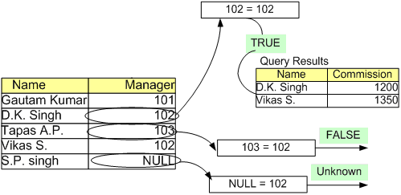
Retrieving a subset of rows (Working of WHERE Clause)
Problem Statement: To select rows which have 102 in the Manager column.
Row selection with the WHERE clause

Slide 44
Relational operators
List all customers with an account balance > $10000
SELECT Account_No, Total_Available_Balance_in_Dollars
FROM Customer_Transaction
WHERE Total_Available_Balance_in_Dollars > 10000.00;
List the Cust_ID, Account_No of ‘Graham’
SELECT Cust_ID, Account_No
FROM Customer_Details
WHERE Cust_First_Name = ‘Graham’;
Relational operators
= , < , > , <= , >= , != or < >

Slide 45
Relational operators
List all Account_No where Total_Available_Balance_in_Dollars is atleast $10000.00
SELECT Account_No
FROM Customer_Transaction
WHERE Total_Available_Balance_in_Dollars >= 10000.00;

Slide 46
Logical operators
  List all Cust_ID, Cust_Last_Name where Account_type is ‘Savings’ and Bank_Branch is ‘Capital Bank’.
SELECT Cust_ID, Cust_Last_Name
FROM Customer_Details
WHERE Account_Type = ‘Savings’
AND Bank_Branch = ‘Capital Bank’;
List all Cust_ID, Cust_Last_Name where neither Account_type is ‘Savings’ and nor Bank_Branch is ‘Capital Bank’
SELECT Cust_ID, Cust_Last_Name
FROM Customer_Details
WHERE NOT Account_Type = ‘Savings’
AND NOT Bank_Branch = ‘Capital Bank’;

Slide 47
Logical operators
List all Cust_ID, Cust_Last_Name where either Account_type is
‘Savings’ or Bank_Branch is ‘Capital Bank’.
SELECT Cust_ID, Cust_Last_Name
FROM Customer_Details
WHERE Account_Type = ‘Savings’
OR Bank_Branch = ‘Capital Bank’;
Logical operator: AND, OR, and NOT

Slide 48
Retrieval using BETWEEN
List all Account_Nos with balance in the range $10000.00 to $20000.00.
SELECT Account_No
FROM Customer_Transaction
WHERE Total_Available_Balance_in_Dollars >= 10000.00
AND Total_Available_Balance_in_Dollars <= 20000.00;
Or
SELECT Account_No
FROM Customer_Transaction
WHERE Total_Available_Balance_in_Dollars
BETWEEN 10000.00 AND 20000.00;
Notes:
BETWEEN:
The BETWEEN operator is used to test a range. BETWEEN A AND B evaluates to TRUE if the value is greater than or equal to A and less than or equal to B.
If NOT is used, the result is the reverse.

Slide 49
Retrieval using IN
List all customers who have account in Capital Bank or Indus Bank.
SELECT Cust_ID
FROM Customer_Details
WHERE Bank_Branch = ‘Capital Bank’
OR Bank_Branch = ‘Indus Bank’;
Or
SELECT Cust_ID
FROM Customer_Details
WHERE Bank_Branch IN (‘Capital Bank’, ‘Indus Bank’);
Notes:
IN and NOT IN:
The IN and NOT IN operators are used to test a membership condition. When using the NOT IN operator, if any value in the list or the result returned from the sub query is NULL, the query returns no rows.

Slide 50
Retrieval using LIKE
List all Accounts where the Bank_Branch begins with a ‘C’ and has ‘a’ as the second character
SELECT Cust_ID, Cust_Last_Name, Account_No
FROM Customer_Details
WHERE Bank_Branch LIKE ‘Ca%’;
List all Accounts where the Bank_Branch column has ‘a’ as the second character.
SELECT Cust_ID, Cust_Last_Name, Account_No
FROM Customer_Details
WHERE Bank_Branch LIKE ‘_a%’;
Notes:
LIKE:
The LIKE operator is used to perform pattern matching. The pattern-search character % is used to match any character and any number of characters. The pattern-search character _ is used to match any single character.

Slide 51
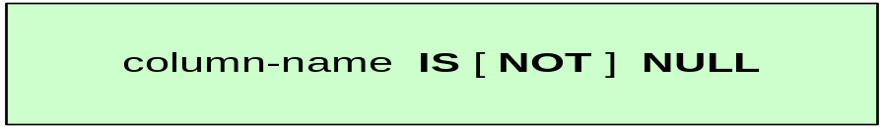
SQL - Retrieval using IS NULL
List employees who have not been assigned a Manager yet.
SELECT Employee_ID
FROM Employee_Manager
WHERE Manager_ID IS NULL;
List employees who have been assigned to some Manager.
SELECT Employee_ID
FROM Employee_Manager
WHERE Manager_ID IS NOT NULL;
Notes:
IS NULL:
To find the NULL values or the NOT NULL values, you need to use the IS NULL operator. The = or != operator will not work with NULL values. IS NULL evaluates to TRUE if the value is NULL. IS NOT NULL evaluates to TRUE is the value is not NULL.

Slide 52
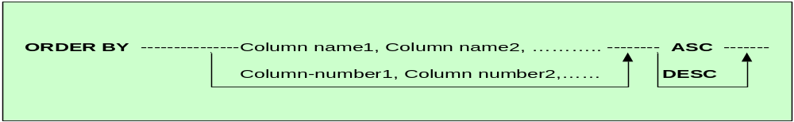
SQL - Sorting your results (ORDER BY)
List the customers account numbers and their account balances, in the increasing order of the balance
SELECT Account_No, Total_Available_Balance_in_Dollars
FROM Customer_Transaction
ORDER BY Total_Available_Balance_in_Dollars;
by default the order is ASCENDING
Notes:
Column alias names can be used in the ORDER BY clause.

Slide 53
Retrieval using ORDER BY
List the customers and their account numbers in the decreasing order of the account numbers.
SELECT Cust_Last_Name, Cust_First_Name, Account_No
FROM Customer_Details
ORDER BY 3 DESC;
Notes:
Not only can you use the column name or the column alias to sort the result set of a query, you can also sort the results by specifying the position of the column in the SELECT clause.

Slide 54
Retrieval using ORDER BY
List the customers and their account numbers in the decreasing order of the Customer Last Name and increasing order of account numbers.
SELECT Cust_Last_Name, Cust_First_Name, Account_No
FROM Customer_Details
ORDER BY Cust_Last_Name DESC, Account_No;
Or
SELECT Cust_Last_Name, Cust_First_Name, Account_No
FROM Customer_Details
ORDER BY 1 DESC, 3;

Slide 55
Aggregate Functions

Slide 56
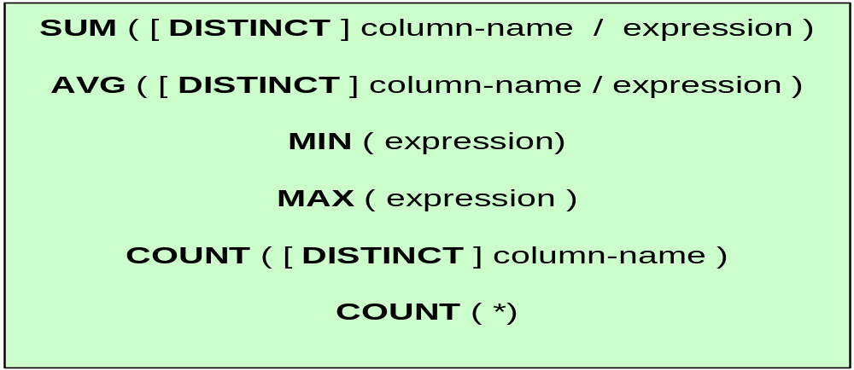
SQL - Aggregate functions
Used when information you want to extract from a table has to do with the data in the entire table taken as a set.
Aggregate functions are used in place of column names in the SELECT statement
The aggregate functions in sql are :
SUM( ) , AVG( ) , MAX( ) , MIN( ), COUNT( )
Notes:
Group functions do not process NULL values and do not return a NULL value, even when NULL are the only values evaluated. For example, a COUNT or SUM of NULL values will result in 0.

Slide 57
Aggregate function - MIN
Returns the smallest value that occurs in the specified column
Column need not be numeric type
List the minimum account balance.
SELECT MIN (Total_Available_Balance_in_Dollars)
FROM Customer_Transaction;
Notes:
MIN:
This function has the syntax MIN([{DISTINCT | ALL }] <x>), where x is an expression. This function returns the lowest value in the expression x.
If the expression x is a date data type, it returns a DATE. For dates, the minimum is the earliest date.
If the expression x is a numeric data type, it returns a NUMBER. For numbers, the minimum is the smallest number.
If the expression is a character data type, it returns a VARCHAR2. for character strings, the minimum is the one that sorts lowest based on the database character set.

Slide 58
Aggregate function - MAX
Returns the largest value that occurs in the specified column
Column need not be numeric type
Example:
List the maximum account balance.
SELECT MAX (Total_Available_Balance_in_Dollars)
FROM Customer_Transaction;
Notes:
MAX:
This function has the syntax MAX([{DISTINCT | ALL }] <x>), where x is an expression. This function returns the highest value in the expression x.
If the expression x is a date data type, it returns a DATE. For dates, the maximum is the latest date.
If the expression x is a numeric data type, it returns a NUMBER. For numbers, the maximum is the largest number.
If the expression is a character data type, it returns a VARCHAR2. for character strings, the maximum is the one that sorts lhighest based on the database character set.

Slide 59
Aggregate function - AVG
Returns the average of all the values in the specified column
Column must be numeric data type
Example:
List the average account balance of customers.
SELECT AVG (Total_Available_Balance_in_Dollars)
FROM Customer_Transaction;
Notes:
AVG:
This function has the syntax AVG ( [DISTINCT | ALL] <n>), where n is a numeric expression. The AVG function returns the mean of the expression n. If neither DISTINCT nor ALL is specified in the function call, the default is ALL.

Slide 60
Aggregate function - SUM
Adds up the values in the specified column
Column must be numeric data type
Value of the sum must be within the range of that data type
Example:
List the minimum and Sum of all account balance.
SELECT MIN (Total_Available_Balance_in_Dollars),
SUM (Total_Available_Balance_in_Dollars)
FROM Customer_Transaction;

Slide 61
Aggregate function - COUNT
Returns the number of rows in the table
List total number of Employees.
SELECT COUNT (*)
FROM Employee_Manager;
List total number of Employees who have been assigned a Manager.
SELECT COUNT (Manager_ID)
FROM Employee_Manager;
Count(*) = No of rows, regardless of NULLs
Count(ColumnName) = No. of rows that do not have NULL Value
Notes:
COUNT:
The COUNT function returns the number of rows in the query. The asterisk (*) is a special quantity – it counts all rows in the result set, regardless of NULLs.

Slide 62
Aggregate function - COUNT
List total number of account holders in the ‘Capital Bank’ Branch.
SELECT COUNT (*)
FROM Customer_Details
WHERE Bank_Branch = ‘Capital Bank’;
List total number of unique Customer Last Names.
SELECT COUNT (DISTINCT Cust_Last_Name)
FROM Customer_Details;
Count(*) = No of rows, regardless of NULLs
Count(ColumnName) = No. of rows that do not have NULL Value

Slide 63
Summary of basic DDL and DML
Create , Alter and Drop are the DDL commands
Update, Insert into, Delete from, are the basic DML commands that add or remove data from tables
Select statement in its various flavours is used to retrieve information from the table
Aggregate functions work on all the rows of the table taken as a group (based on some condition optionally)

Slide 64
Thank You
“The contents of this document are proprietary and confidential to Infosys Technologies Ltd. and may not be disclosed in whole or in part at any time, to any third party without the prior written consent of Infosys Technologies Ltd.”
“© 2006 Infosys Technologies Ltd. All rights reserved. Copyright in the whole and any part of this document belongs to Infosys Technologies Ltd. This work may not be used, sold, transferred, adapted, abridged, copied or reproduced in whole or in part, in any manner or form, or in any media, without the prior written consent of Infosys Technologies Ltd.”

